Slide 1
Rubric
Describing the project goals, data, methods, and results
Explicitly connecting the descriptions of the project to stakeholder needs
Having a distinct introduction and conclusion
Using plain language and clear visuals accessible to non-technical stakeholders

Slide 2

AI Academy Capstone Project – Group 5

Slide 3





Meet the team
Deloitte AI Academy – Capstone Group 5
Jahnavi Brahmbhatt
Miguel Cruz Le Hardy
Brandon Cancino Meyer
Landon Steele
Patricio Solorio Cabrera
Risk & Financial Advisory Analyst
Cyber & Strategic Risk
Costa Mesa, CA
DC Junior Associate
New Business Innovation (NBI)
New Orleans, LA
USDC Analyst
AI & Data Engineering
US - Hermitage
Risk & Financial Advisory Analyst
Accounting & Internal Controls
Dallas, TX
XMX Intern
National Consulting - ARDC
US - Hermitage

Slide 4
Agenda
Questions?
We will save time for Q&A at the end of the presentation.
1.
Elevator Pitch
2.
Business Problem
3.
Data
4.
Q&A
5.
Next Steps

Slide 5

Business Understanding
Evaluating the opportunity at hand for Computing Vision.
MARKET TREND
BUSINESS OPPORTUNITY
STRATEGICAL APPROACH

Slide 6
Elevator Pitch
Approach, Scope, & objectives
Subtitle
GUIDING PRINCIPLES
INTERVIEW / RESEARCH SCOPE (conducted 2017)
Objective: Provide trends and leading practices aligned to Customer Journey and Data-driven Operating Model (DDOM) Modules
Key Drivers:
Industry: Focus on consumer facing software/tech. Additional insights gained from other “customer centric” industries (e.g. retail, financial services etc.)
Business Model: Focus on subscription business models, reliant on annual recurring revenue. Additional insights from business models driven by retention/churn
Company Interviews | Deloitte Quals / Other
Software/Tech (subscription model) Company (Audible), TBC Company (Prime), TBC Company, Marketing Manager Company, Senior Manager (Digital Marketing) Company, Senior Manager (Strategy & Analytics) Company, Global Head of Growth Company, Marketing Manager (Monetization) Company, Senior Director (Marketing) Company (Company), Marketing Lead Others Company, Experiences Marketing Manager Company (Marketplace), TBC Company, Senior Manager of Acquisition Company, TBC | Client Client Client Client Client
Notes:
Tags: approach, analysis, objectives, drivers, principles, interview

Slide 7




Data Understanding
Overview of data sources, & information gained from each.
2 Data Sets
1 Data Set
1 Data Set
1 Data Set
Used for Movie Attributes | Used for Financial Analysis
Important Columns | Genre Director Writer
Limited number of box office observations. | Limited number of box office observations, primary purpose of data is not financial
Used for Movie Review / Rating Analysis | Used for Financial Analysis
Important Columns | Fresh
Utilized Fresh/Rotten score to standardize review analysis. | Both tables were joined to analyze reviews based on movie attributes Added column to return 1 if review is fresh (good), and 0 if rotten (bad)
Used for Financial Analysis | Used for Financial Analysis
Important Columns | Title Production Budget Domestic Gross Worldwide Gross
Domestic Gross & Worldwide Gross are a sum of only box office income. Added column: “Profit”, to find difference between Worldwide Gross & Production Budget. | Domestic Gross and Worldwide Gross are a sum of only box office income Added column, “Profit”, to find difference between Worldwide Gross and Product Budget
Used for Movie Characteristics & Ratings | Used for Financial Analysis
Important Columns | Title Vote Average Original Language
Used for Financial Analysis | Used for Financial Analysis
Important Columns | Title Studio Domestic Gross Foreign Gross
Domestic Gross & Foreign Gross are a sum of only box office income. | Domestic Gross and Foreign Gross are a sum of only box office income
Both tables were joined to analyze reviews based on movie attributes​.
Notes:
Aidan

Slide 8
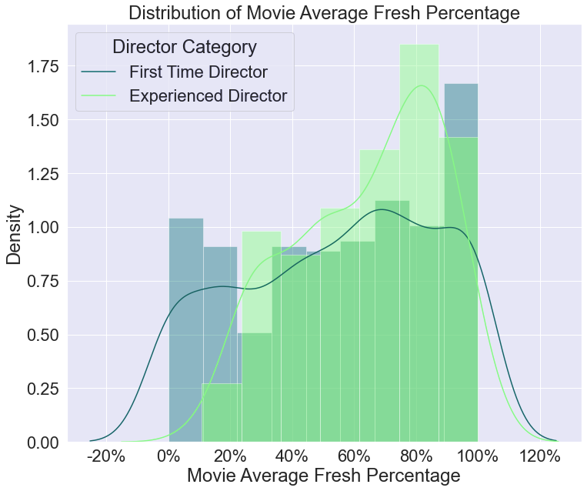
Our Model / Analysis
Does director experience lead to a higher average percentage of Fresh ratings on Rotten Tomatoes?
Null Hypothesis: Distributions of movie Fresh percentage for first time directors are statistically similar to experienced directors.
Alternative Hypothesis: Distributions of movie average Fresh percentage for experienced directors are higher than for first time directors.
Testing Conclusion:
Mann-Whitney U test: Conclude that the movie average fresh percentage is significantly greater for movies that were directed by a director who has worked on 2 or more movies.
Linear Regression Results:
Model 1: As a director gains one movie in experience, the fresh percentage is expected to increase by 5%
Model 2: For every fresh percentage point gained, we can expect to see box office revenue increase by $16.7K
Key Variable: Fresh Percentage
- Sum of Fresh (good) reviews/total number of reviews.
Key Variable: Movie Average Fresh Percentage
- Average of fresh percentage = All percentages/number of movies directed.
Rotten Tomatoes Reviews*
Notes:
Aidan

Slide 9

Recommendations
PRODUCE AN ADVENTURE MOVIE
To maximize profitability the company should implement the following recommendations.
GO GLOBAL
Our analysis indicates it is the most profitable genre and is averagely reviewed.
Not only does this impact profit but also essential to language variety worldwide.
FOCUS ON THAI AND JAPANESE LOCALIZATIONS
HIRE EXPERIENCED DIRECTORS
Directors with more than one movie under their belt tend to have better rated movies.
For an international release, the Asian market should be prioritized.
Notes:
Tags: DNA, underline, text

Slide 10
Conclusion
The unpredictable business climate and volatile market is increasing pressure on companies to perform
The market is looming in uncertainty…
…leading to rampant investor pressure on organizations to act
ECONOMIC TRENDS¹
As the environment changes, there is growing pressure on consumer brands to emulate the qualities of startups such as building flexible supply chains, tightening operating expenses & overhead, and increased investment in growth opportunities.
Slow growth in developed economies
Top 250, 5yr Retail Revenue CAGR
9.1%
5.4%
4.8%
22%
56%
$280M
FY2006
FY2011
FY2016
Low inflation despite tighter labor markets
1.9%
2018 average US inflation
of CPGs have turned to Zero-Based Budgeting (ZBB)²
increase in the usage of ZBB in 2017 compared to 2016³
on average saved by firms per year with the help of ZBB³
Asset price bubbles & risk from monetary tightening
Sharp rise in asset prices including equities, bonds, and property
1. Deloitte CIP Global Powers of Retailing 2018 Report
2. Deloitte Commercial spend in consumer products: 2016
3. “Global Companies Extend Use of Zero-Based Budgeting to Slash Costs” Wall Street Journal 2018
Notes:
Tags: text, landscape, data visualization, trends

